Slide 1

 | BMS INSTITUTE OF TECHNOLOGY & MANAGEMENT, YELAHANKA, BANGALORE. Department of Computer Science & Engineering
TECHNICAL Seminar on :
OBJECT Detection using YOU ONLY LOOK ONCE (YOLO) ALGORITHM
By:
MOHAMMED DAANIYAAL - 1BY15CS051
Under the guidance of:
DR.ANUPAMA HS
ASSOCIATE PROFESSOR, CSE
BMSIT&M

Slide 2
ABSTRACT
Humans can easily detect and identify objects present in an image.
Object Detection is recognizing different objects in a scene / image.
With the availability of large amounts of data, faster Graphical Processing Units (GPU’s), and faster algorithms, computers can be trained to detect objects.
With several algorithms for object detection such as Convolutional Neural Networks (CNN), YOLO algorithm is the state of the art algorithm for object detection.

Slide 3
INTRODUCTION
Object detection is a computer technology related to computer vision and image processing that deals with detecting instances of objects is images and videos.
It involves object detection, object localization and object classification.
Object detection involves drawing a boundary box around the detected object and classifying it based on the classes of data it is trained on.
Object detection has applications in many areas of computer vision, including video surveillance, gesture recognition, autonomous vehicles, etc.

Slide 4
LITERATURE SURVEY
SL.NO | AUTHOR AND YEAR OF PUBLICATION | METHODOLOGY | ADVANTAGES | LIMITATIONS
1. | Joseph Redmon, Santosh Divvala, Ross Girshick Ali Farhadi You Only Look Once: Unified, Real-Time Object Detection – May 2016. | Detects objects in a single pass by dividing the input image into S x S grids. Processes images at 45 fps. | YOLO is extremely fast. Out performs CNN. YOLO achieves more than twice the mean average precision of other real-time systems. | YOLO imposes strong spatial constraints on bounding box predictions since each grid cell only predicts two boxes
2 | Joseph Redmon, Ali Farhadi YOLO9000: Better, Faster, Stronger – December 2016. | YOLO9000 also known as YOLOv2 is an improvised version of YOLO algorithm and is capable of detecting over 9000 object categories. Each prediction includes 4 parameters for the boundary box, 1 box confidence score (objectness) and 20 class probabilities. i.e. 5 boundary boxes with 25 parameters: 125 parameters per grid cell. | Improves accuracy by moving the class prediction from the cell level to the boundary box level | Difficult to detect objects when too many objects are overlapped.

Slide 5
3. | Hyeok-June Jeong, Kyeong-Sik Park, Young-Guk Ha Image Preprocessing for Efficient Training of YOLO Deep Learning Networks. – January 2018. | This paper implements a pre-processor for YOLO object detector. | Since the images are pre-processed the performance of YOLO is better when compared to the performance without pre-processing. | The response / detection time is more due to the pre-processing of images. Also this methodology cannot be used for real time systems.
4. 5.

Slide 6
6.
7.

Slide 7
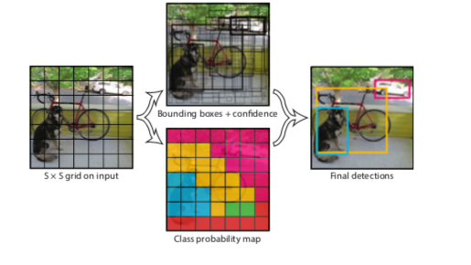
Methodology
A single convolutional network simultaneously predicts multiple bounding boxes and class probabilities for those boxes.
This system divides the input image into an S × S grid .
Each grid cell predicts B bounding boxes and confidence scores for those boxes.

Slide 8
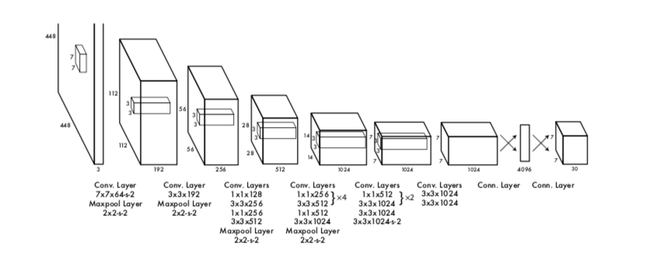
METHODOLOGY (CONTD.)
Each bounding box consists of 5 predictions: x, y, w, h, and confidence.
Finally, predicts C conditional class probabilities,
Pr(Classi |Object).
The final output of our network is the 7 × 7 × 30 tensor of predictions.

Slide 9
Different versions of YOLO
YOLOv2 : Improvised version of the YOLO algorithm to detect more than 9000 classes of images.
YOLO – R : Designed for pedestrian detection by adding a Passthrough layer which obtains the depth feature.
YOLO – LITE : A spatial refinement module is implemented for running this version of YOLO on portable devices such as mobiles and tablets which lack a GPU.
YOLOv3 : This is the newest version of YOLO for real-time detection.

Slide 10
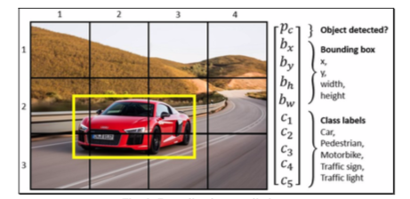
YOLOv3 FOR TRAFFIC PARTICIPANT DETECTION IN REAL TIME
The system captures the video in real time.
It then extracts images / frames from the video captured, scales the image to 416 x 416 and passes that image to the YOLOv3.
YOLOv3 then outputs objects detected, tracking and to the class to which the object belongs.

Slide 11
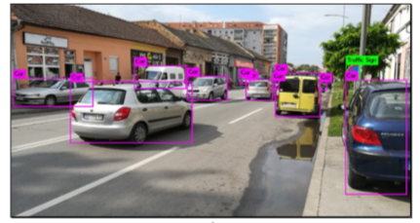
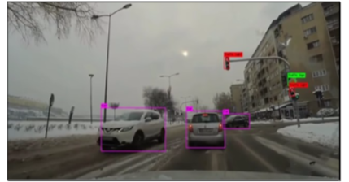
RESULTS AND DISCUSSION
The neural network was trained for 120 epochs and that took two weeks .
The YOLO algorithm processed input video stream from the dashboard camera with the frame resolution 1920 x 1080 px at the average of 23 frames per second.

Slide 12
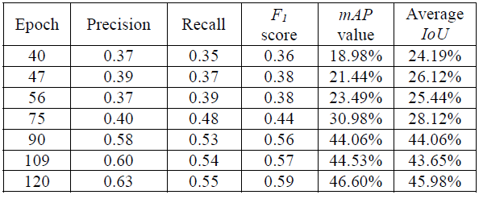
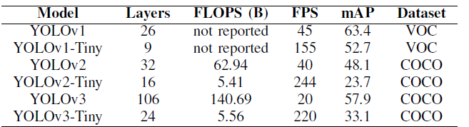
Results (contd.)
Training YOLOv3 Result
Comparisons of different versions of YOLO

Slide 13
CONCLUSION

